Slide 1
Spring 2021
DATS 501 Fundamentals of Data Science
Cumhur Baştürk
basturkc.academic@gmail.com
Hasan Demirtaş
hasan.demirtas@yeditepe.edu.tr
hdemirtas.academic@gmail.com

Slide 2
NAÏVE BAYES CLASSIFIER

Slide 3
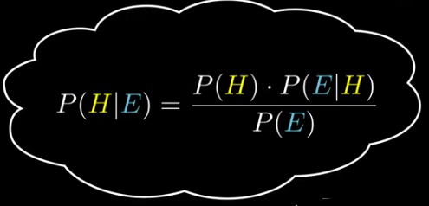
NAÏVE BAYES CLASSIFIER
Introduction
Naïve Bayes is a classification algorithm that works based on the Bayes’ theorem.
Before explaining about Naïve Bayes, first, we should discuss Bayes’ Theorem.
Bayes’ theorem is used to find the probability of a hypothesis with given evidence.
We'll try to understand the formula

Slide 4
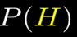
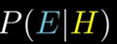


NAÏVE BAYES CLASSIFIER
Levels of understanding
Probability a hypothesis is true (before any evidence)
Probability of seeing the evidence if hypothesis is true
Probability of seeing the evidence
Probability a hypothesis true given some evidence

Slide 5

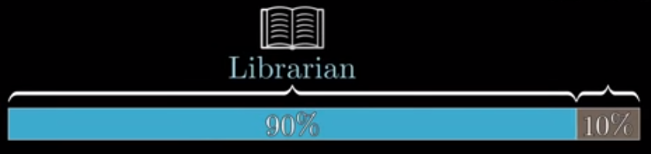
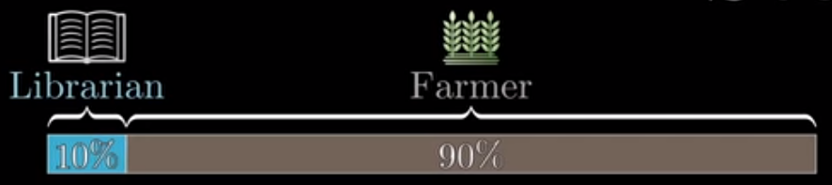
NAÏVE BAYES CLASSIFIER
Example
Steve is very shy and withdrawn, invariably helpful but with very little interest in people or in the world of reality. A meek and a tidy soul, he has a need for order and structure, and a passion for detail.
Which of the following do you find more likely?

Slide 6
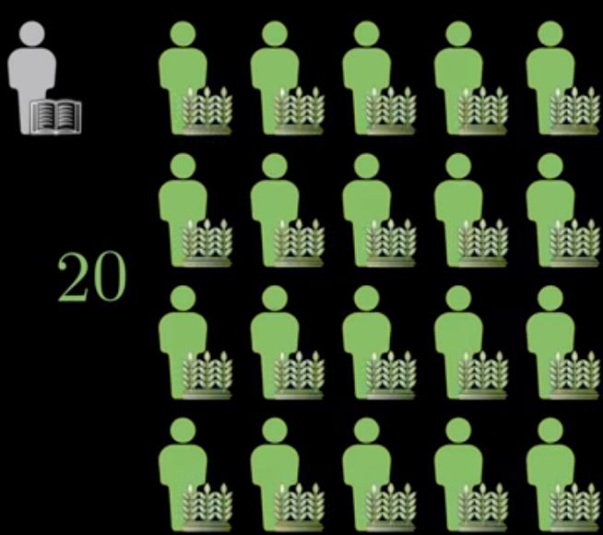
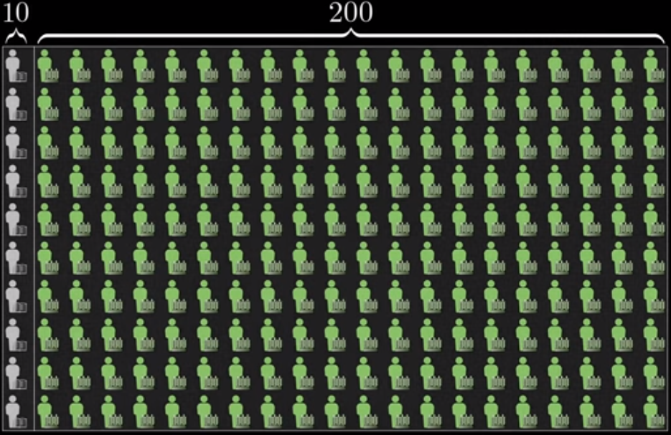
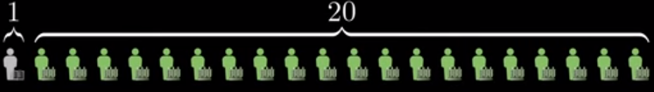
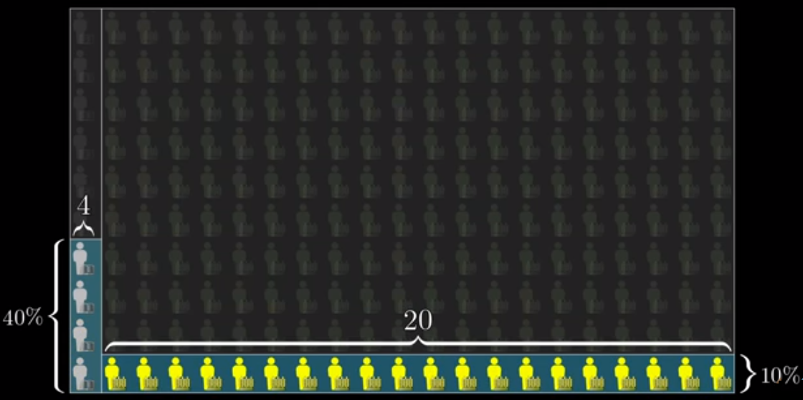
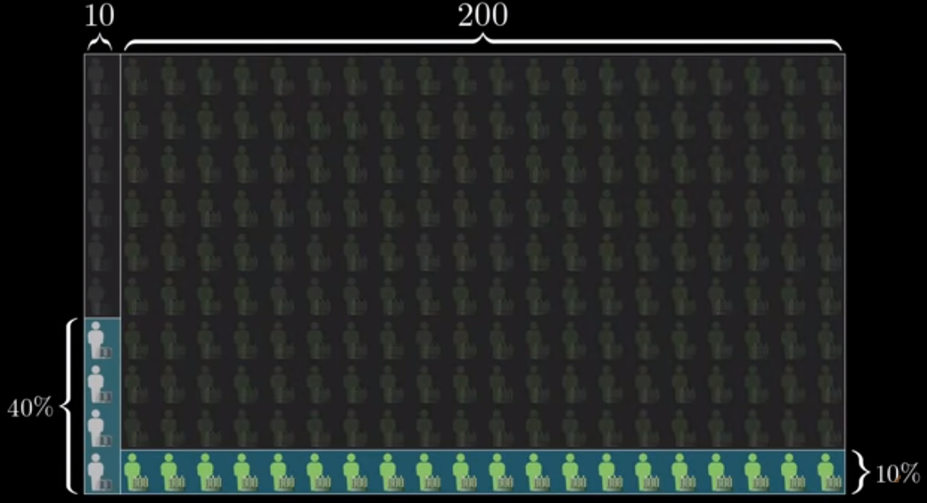
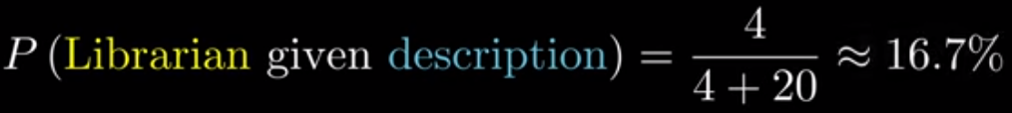
NAÏVE BAYES CLASSIFIER

Slide 7
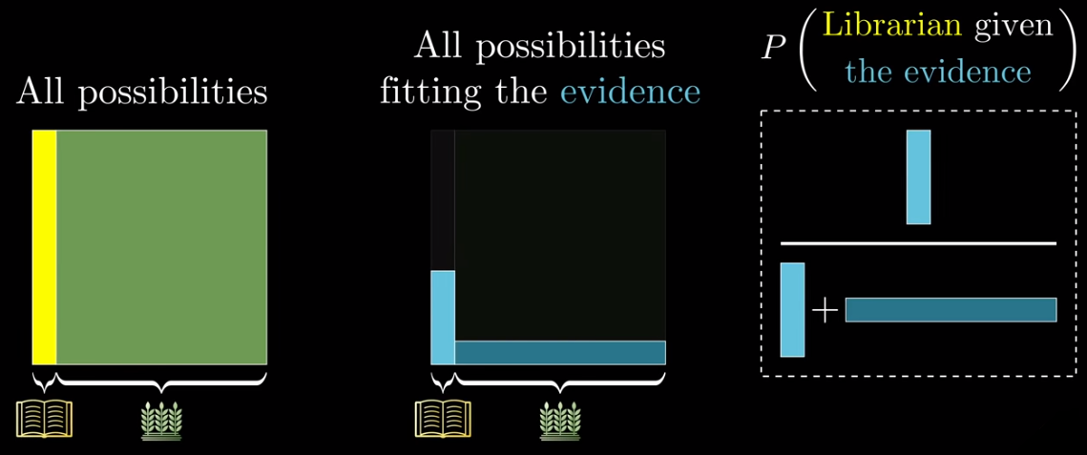
NAÏVE BAYES CLASSIFIER
Heart of Bayes' theorem

Slide 8
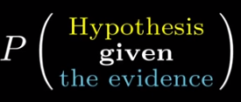
NAÏVE BAYES CLASSIFIER
When to use Bayes' theorem?
You have a hypothesis
You've observed some evidence
You want

Slide 9
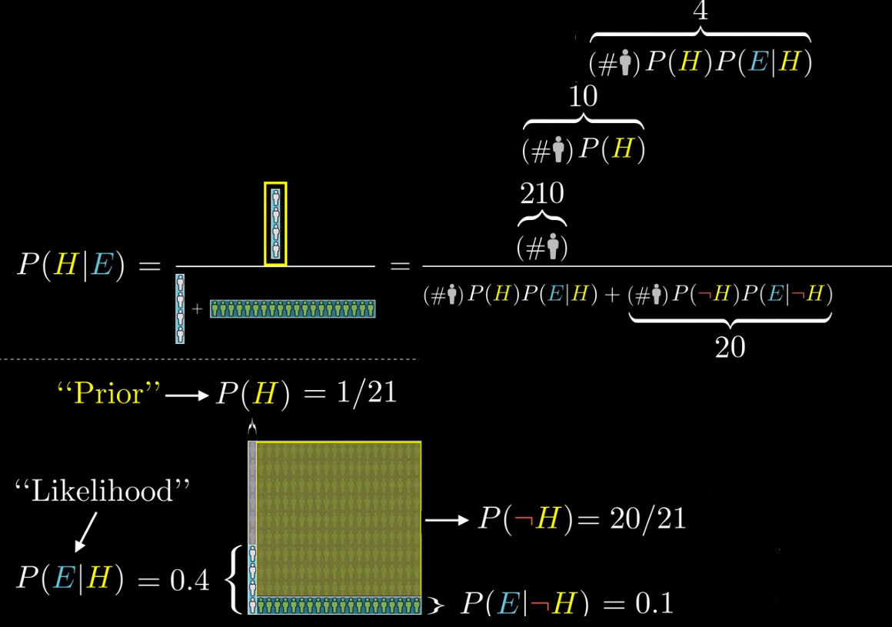
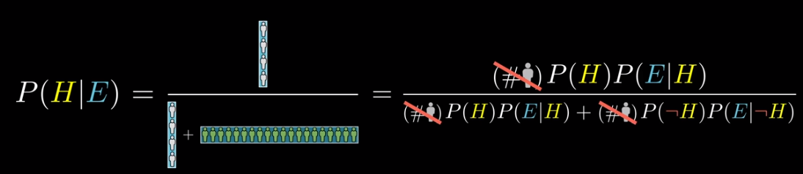
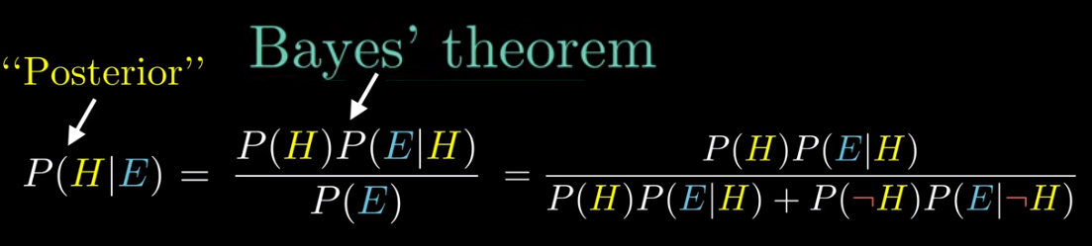
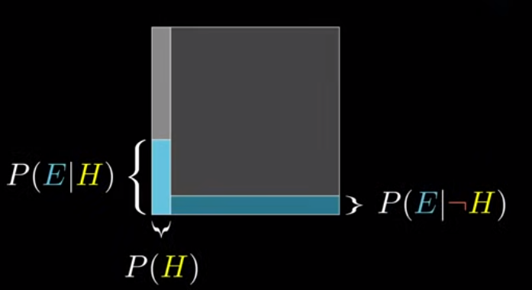
NAÏVE BAYES CLASSIFIER

Slide 10
NAÏVE BAYES CLASSIFIER
Naive-Bayes algorithm for predictive modeling
– A statistical classifier that can predict class membership probabilities (a generative method)
– Despite its simplicity, it’s surprisingly accurate
– Underlying probabilistic model: The Bayes Theorem
– Basic assumption: Given a class, every attribute is independent of all other attributes (the value of one feature has no effect on that of another – thus the word "Naive"... more on this later). This is hardly ever true, but it works pretty well in most cases.

Slide 11
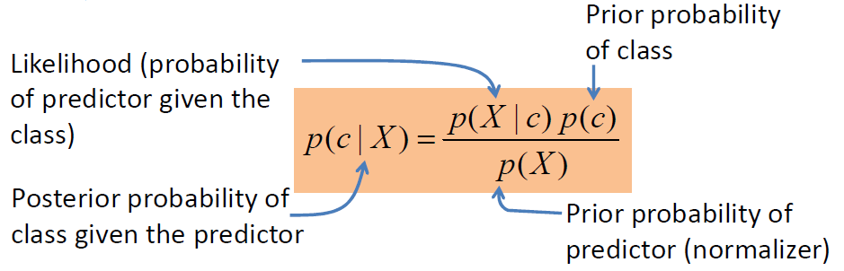
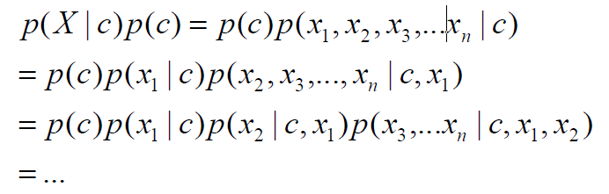
NAÏVE BAYES CLASSIFIER
Why is NB so popular?
• Classification problem: What is the probability of class c given the set of features by X? It follows from the Bayes’ theorem:
• The numerator is computed as follows:

Slide 12
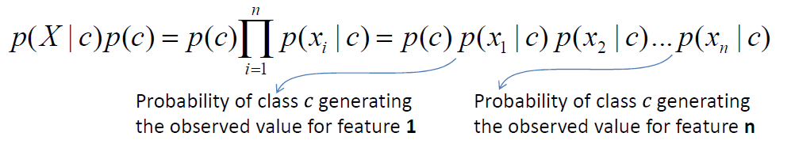
NAÏVE BAYES CLASSIFIER
• It is clear that this is way too complex and a simplification is needed. By assuming all features are conditionally independent, last equation in the previous slide can be further simplified into the following form:
• It all comes down to counting and multiplication which can all be pre-computed. Classification then becomes easy and fast. Assign the class label of whichever has the highest likelihood and it’s done!

Slide 13
NAÏVE BAYES CLASSIFIER
Types of NB models
• Based on the assumption for distribution of p(X|c):
• Gaussian NB
– Used for continuous data (real numbers), features are assumed to follow a Normal (Gaussian) distribution
• Multinomial NB
– Represents the frequencies with which certain events have been generated (useful if your features are discrete such as counting how often a word occurs in a text document)
• Bernoulli NB
– Used when the feature vectors are binary (the binomial model – used in classifying a word’s presence or absence in a text document such as spam detection)

Slide 14
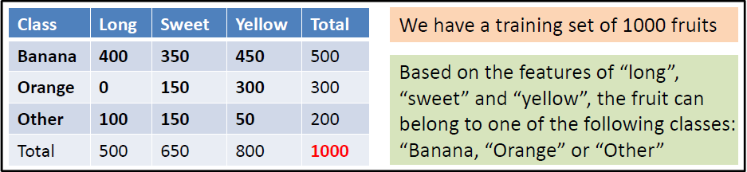
NAÏVE BAYES CLASSIFIER
Example
• New data: {long, sweet, yellow} => What is the likelihood of this fruit being any one of the classes?
• Step 1: Let’s calculate the probability that the fruit is a banana
• Assume the features are conditionally independent (given B):

Slide 15
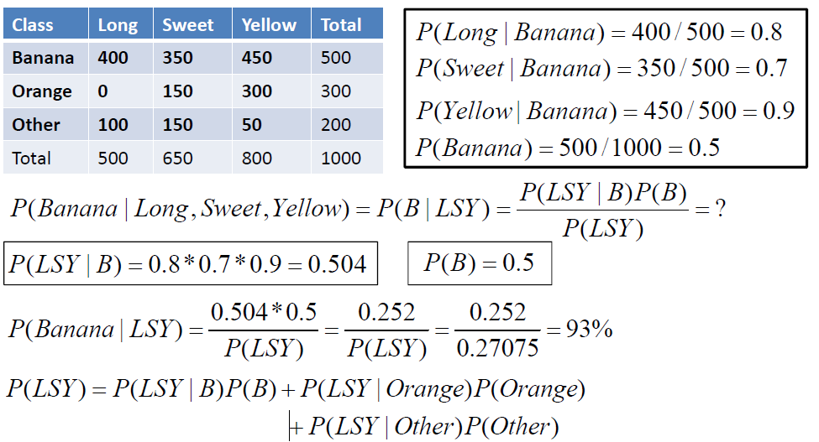
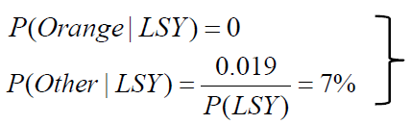
NAÏVE BAYES CLASSIFIER
• Step 2: Let’s work out the equations above and plug them in
• Carrying out the same computation for the other two classes:
Given the current attributes, Naive-Bayes classifies the fruit as Banana

Slide 16
NAÏVE BAYES CLASSIFIER
Problems with NB
• Zero Frequency (zero observation) problem
– When a categorical feature has a value not observed in the training set but present in the test set, the model assigns a 0 probability and is unable to make a prediction. To fix it, we
apply a smoothing technique (Laplace correction) and add 1 to every feature. This is essentially assigning an arbitrarily low probability to that class to make it different from zero.
• Not much "fine-tuning"
– NB classifiers have limited options for parameter tuning. So it’s best to focus on data pre-processing and feature selection.
• No combination of classifiers
– Combination of classifiers (like ensembling, bagging and boosting) won’t help with NB as the purpose with these techniques is to reduce the variance. NB has no variance to
minimize.
• Deviations from normality
– For continuous features that don’t follow a Normal distribution, try variable transformation.

Slide 17
NAÏVE BAYES CLASSIFIER
Improving NB
• Use log probabilities
– Probabilities can be really small numbers and often lead to inaccurate results (due to precision of floating point values) when multiplied together. It is best to work in the
logarithmic realm and add them up rather than multiply them. You can convert it back to original later.
• Remove redundant features
– Double-counting of correlated features. You can remove one of the highly correlated.
• One vs Rest approach
– For features that have many categorical levels, you can try a two-class feature (category A vs all-else) and keep experimenting with different combinations

Slide 18
NAÏVE BAYES CLASSIFIER
Naive-Bayes w/ Python
#using scikit-learn library
from sklearn.naive_bayes import GaussianNB
from sklearn.metrics import accuracy_score
Clf = GaussianNB()
Clf.fit(X_train, y_train)
accuracy_score(y_test, Clf.predict(X_test))
#Hyperparameters tuned:
#GaussianNB has no hyperparameters

Slide 19
SVM (Support Vector Machines)

Slide 20
SVM (Support Vector Machines)
A Support Vector Machine (SVM) is:
A very powerful and versatile Machine Learning model
Capable of performing linear or nonlinear classification, regression, and even outlier detection.
Particularly well suited for classification of complex but small- or medium-sized datasets.

Slide 21
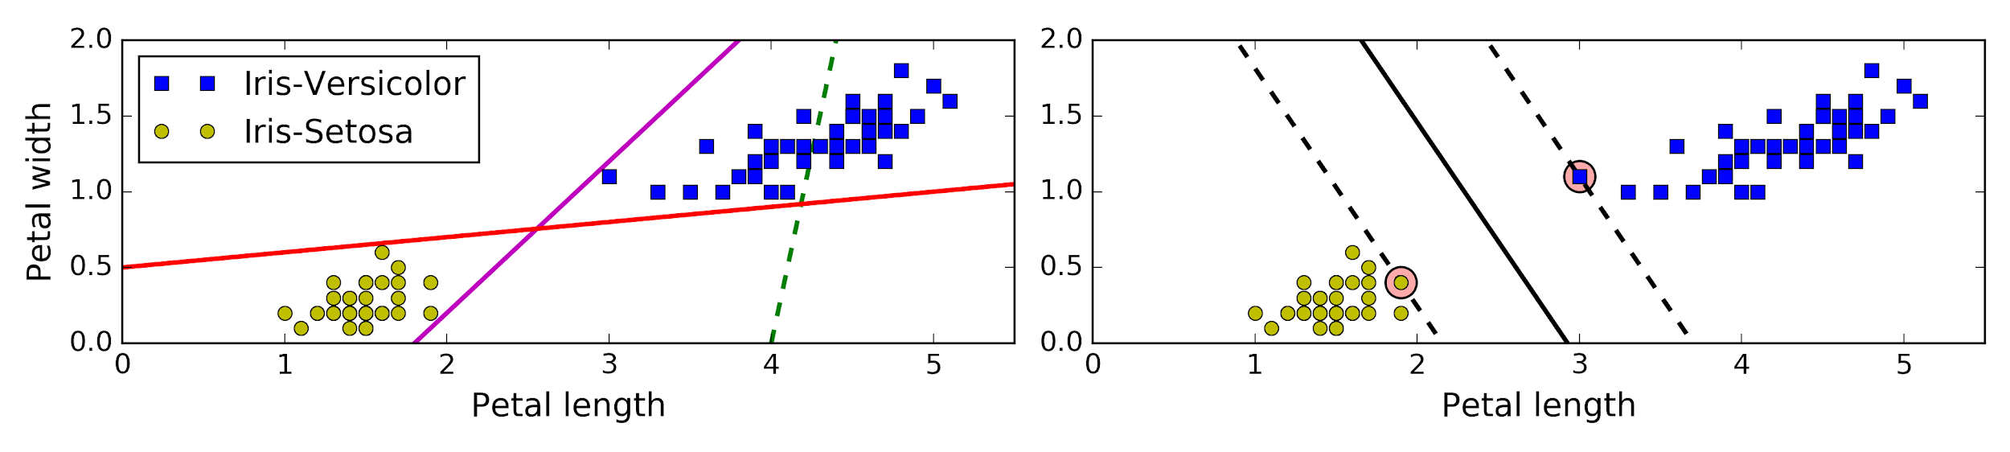
SVM (Support Vector Machines)
The fundamental idea behind SVMs is best explained with some pictures.
Figure shows part of the iris dataset. The two classes can clearly be separated easily with a straight line (they are linearly separable). The left plot shows the decision boundaries of three possible linear classifiers. The model whose decision boundary is represented by the dashed line is so bad that it does not even separate the classes properly. The other two models work perfectly on this training set, but their decision boundaries come so close to the instances that these models will probably not perform as well on new instances. In contrast, the solid line in the plot on the right represents the decision boundary of an SVM classifier; this line not only separates the two classes but also stays as far away from the closest training instances as possible. You can think of an SVM classifier as fitting the widest possible street (represented by the parallel dashed lines) between the classes. This is called large margin classification.
Decision boundary is fully determined (or “supported”) by the instances located on the edge of the street. These instances are called the support vectors (they are circled in Figure).

Slide 22
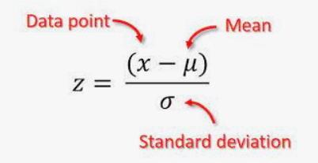
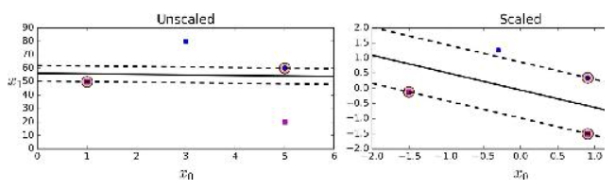
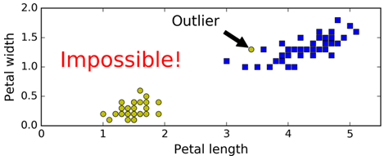
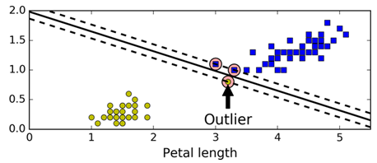
SVM (Support Vector Machines)
SVMs are sensitive to features scales, so that you should scale your data before using SVMs
Hard vs. Soft Margin Classification
If we strictly impose that all instances be off the street and on the right side, this is called hard margin classification.
It works only on linearly separable data.
It is very sensitive to outliers.

Slide 23
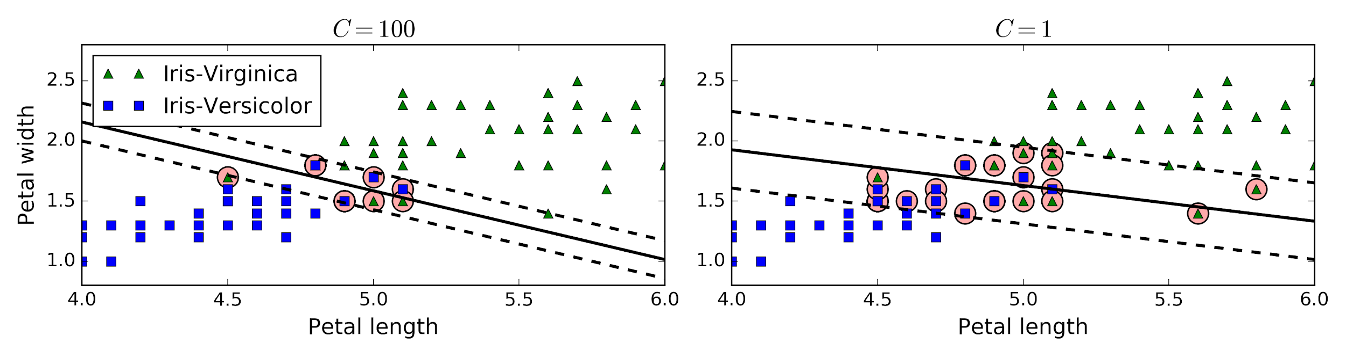
SVM (Support Vector Machines)
The objective is to find a good balance between keeping the street as large as possible and limiting the margin violations (i.e., instances that end up in the middle of the street or even on the wrong side). This is called soft margin classification.
In Scikit-Learn’s SVM classes, you can control this balance using the C hyperparameter: a smaller C value leads to a wider street but more margin violations.
If you have an overfitting problem, then you should use smaller C value.

Slide 24
SVM (Support Vector Machines)
So far, we can say that:
We use SVM to fit the widest possible “street” between the classes. In other words, the goal is to have the largest possible margin between the decision boundary that separates the two classes and the training instances.
When performing soft margin classification, the SVM searches for a compromise between perfectly separating the two classes and having the widest possible street (i.e., a few instances may end up on the street).
Another key idea is to use kernels when training on nonlinear datasets.

Slide 25
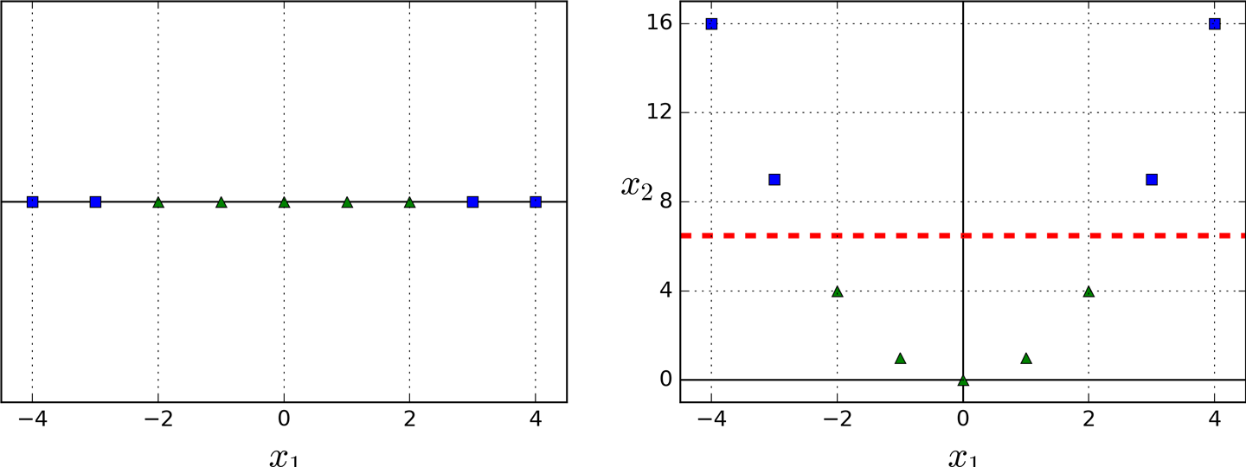
SVM (Support Vector Machines)
Nonlinear SVM Classification
Some problems are not linearly separable. One approach to handling nonlinear datasets is to add more features, (be careful , we do ADD new features!) such as polynomial features; in some cases this can result in a linearly separable dataset. Consider the left plot in Figure: it represents a simple dataset with just one feature x₁. This dataset is not linearly separable, as you can see. But if you add a second feature x₂ = (x₁)², the resulting 2D dataset is perfectly linearly separable
Adding polynomial features is simple to implement and can work great with all sorts of Machine Learning algorithms (not just SVMs), but at a low polynomial degree it cannot deal with very complex datasets, and with a high polynomial degree it creates a huge number of features, making the model too slow.

Slide 26
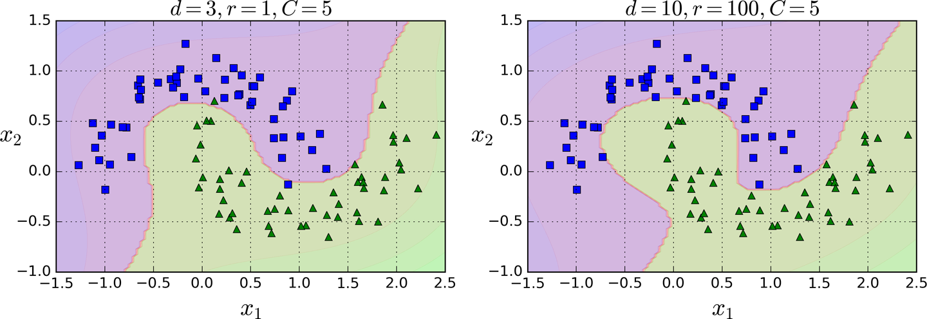
SVM (Support Vector Machines)
Polynomial Kernel
Fortunately, when using SVMs you can apply an almost miraculous mathematical technique called the kernel trick. It makes it possible to get the same result as if you added many polynomial features, even with very high-degree polynomials, without actually having to add them. So there is no combinatorial explosion of the number of features since you don’t actually add any features.
On the left, it is trained an SVM classifier using a 3rd-degree polynomial kernel.
On the right is another SVM classifier using a 10th-degree polynomial kernel.
It shows how much the model is influenced by high-degree polynomials versus low-degree polynomials.

Slide 27
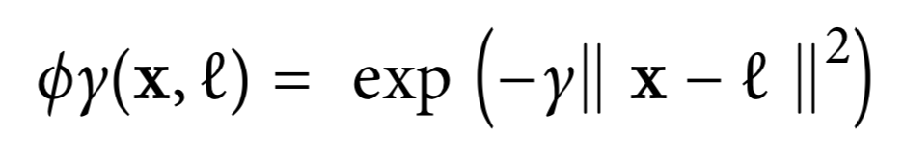
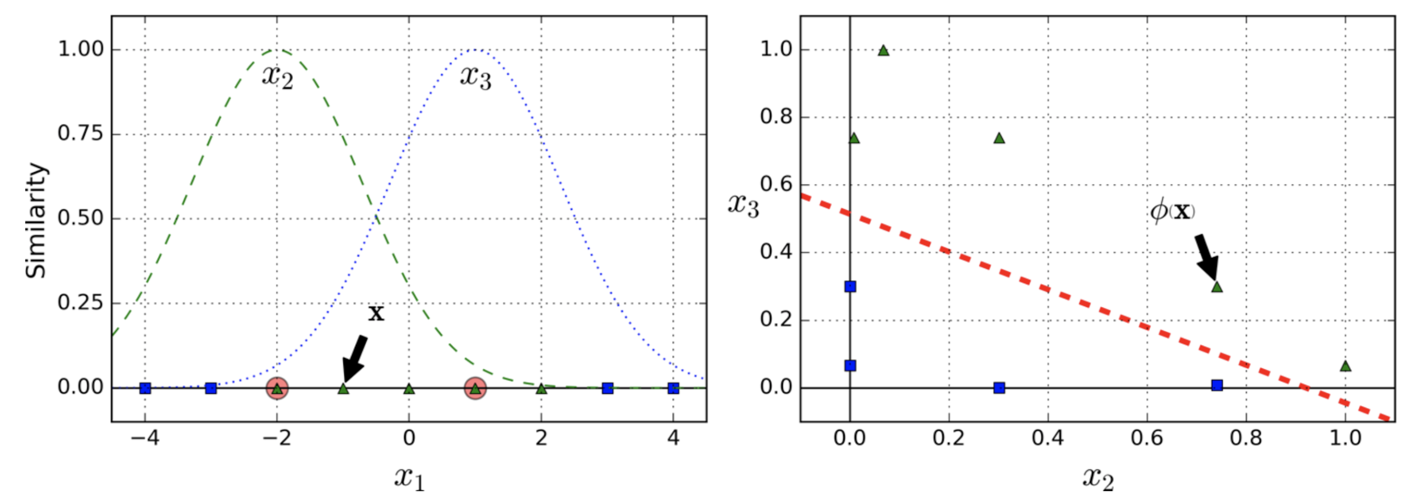
SVM (Support Vector Machines)
Adding Similarity Features
Another technique to tackle nonlinear problems is to add features computed using a similarity function that measures how much each instance resembles a particular landmark.
Gaussian Radial Basis Function (RBF)
Let’s take the one-dimensional dataset discussed earlier and add two landmarks to it at x1 = –2 and x1 = 1
Let’s look at the instance x1 = –1: it is located at a distance of 1 from the first landmark, and 2 from the second landmark.
It is a bell-shaped function varying from 0 (very far away from the landmark) to 1 (at the landmark).
Therefore its new features are x2 = exp (–0.3 × 1^2) ≈ 0.74 and x3 = exp (–0.3 × 2^2) ≈ 0.30. After adding x2 and x3, it becomes linearly separable.
How to select landmarks?
The simplest approach is to create a landmark at the location of each and every instance in the dataset.
But, this would lead m new features. For large number of features, it’s a problem.

Slide 28
SVM (Support Vector Machines)
Gaussian RBF Kernel
Like we did in Polynomial Kernel, we can apply a similar trick with Gaussian RBF Kernel.
It makes possible to obtain a similar result as if you had added many similarity features, without actually having to add them.
Increasing gamma makes the bell-shape curve narrower -> decision boundary will be very close to individual instances.
Decreasing gamma makes the bell-shape curve wider -> decision boundary will be smoother.
If your model is overfitting, you should reduce gamma, and if it is underfitting, you should increase it (similar to the C hyperparameter).

Slide 29
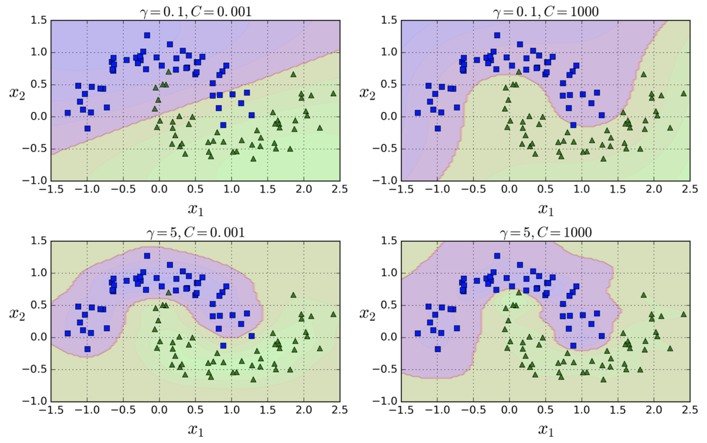
SVM (Support Vector Machines)
Gaussian RBF Kernel

Slide 30
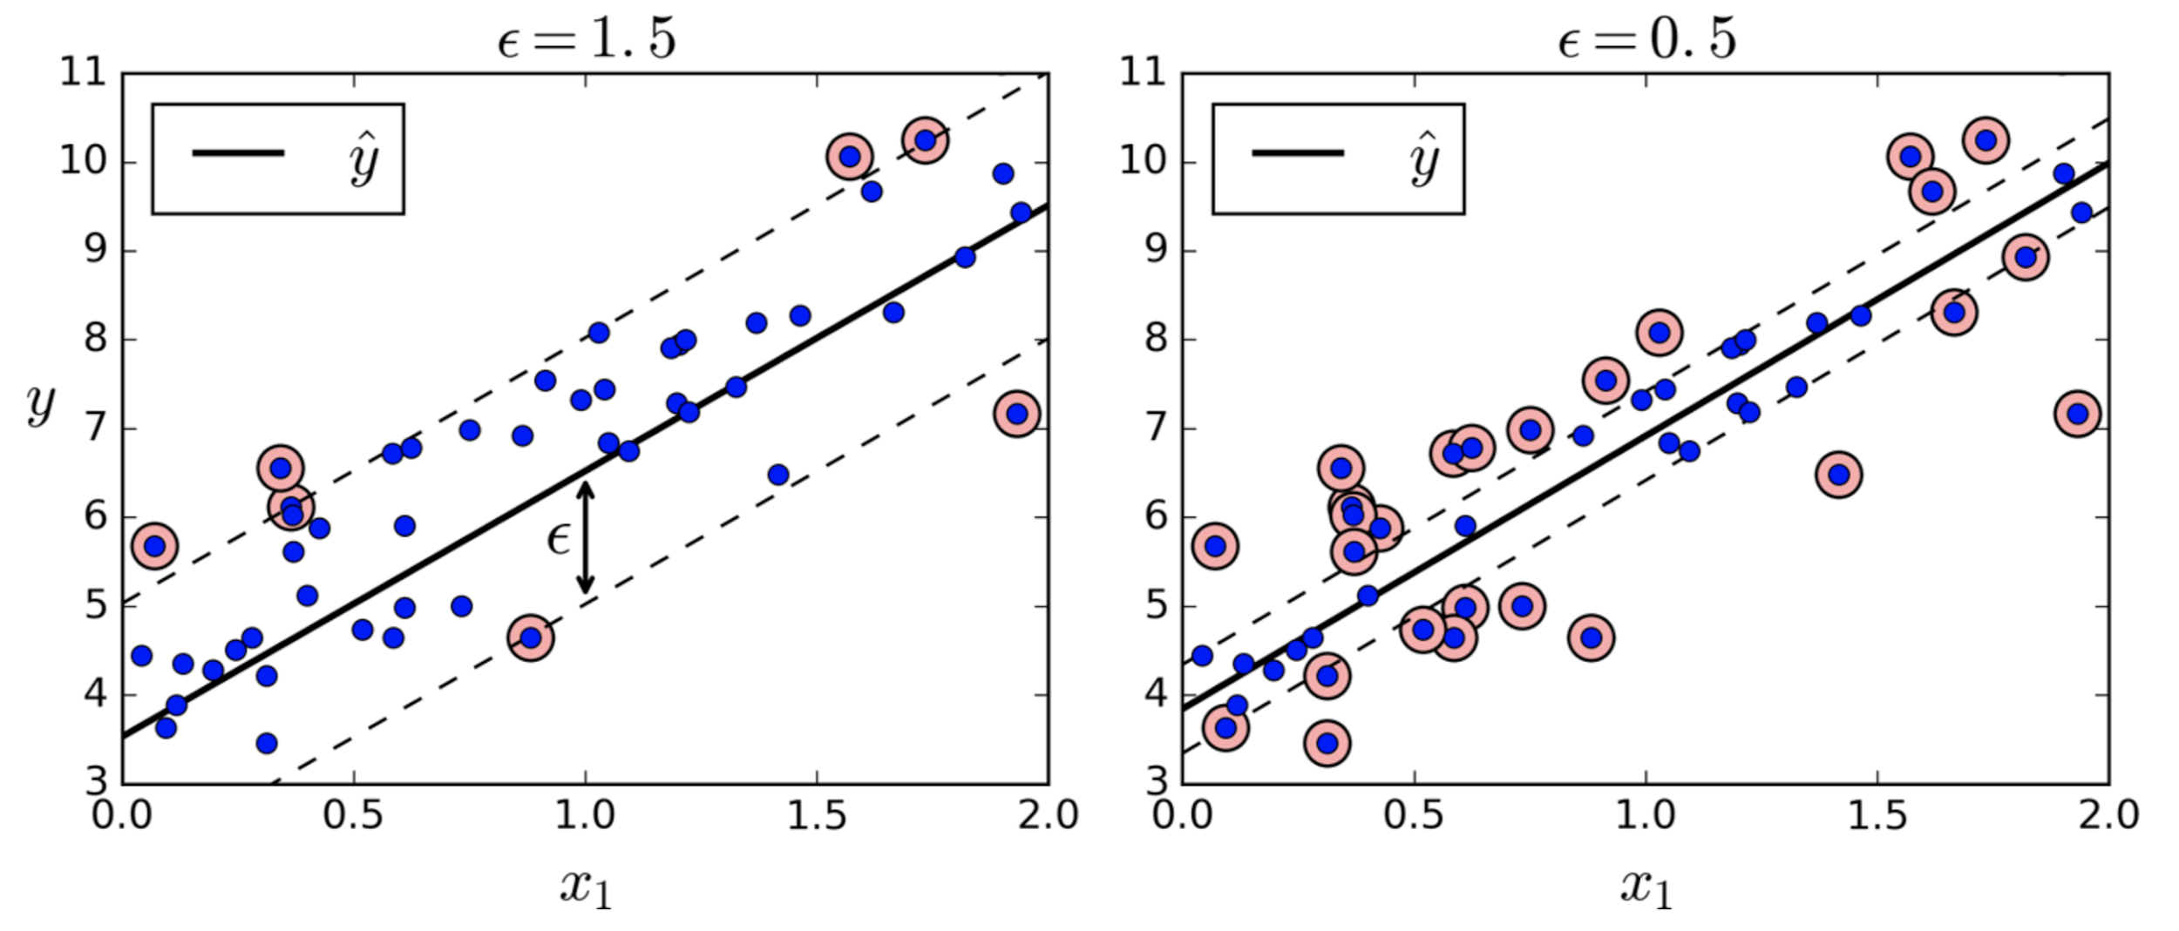
SVM (Support Vector Machines)
SVM Regression
SVM also supports linear and nonlinear regression.
Instead of trying to fit the largest possible street between two classes while limiting margin violations,
SVM Regression tries to fit as many instances as possible on the street while limiting margin violations (i.e., instances off the street).
The width of the margin is controlled by a hyperparameter ε.
Adding more training instances within the margin does not affect the model’s predictions.

Slide 31
k-NN(k-Nearest Neighbors)

Slide 32
K-NN (K-Nearest Neighbors)
Characteristics of kNN
• k-Nearest Neighbors (kNN) for predictive modeling
– A simple, supervised, instance-based classification algorithm
– Non-linear and non-parametric
– A lazy learner (no training)
– Very intuitive (high interpretability)
• Can handle:
– Mixed data types (continuous and categorical)
– Linearly inseparable data
– Multi-class problems
• When to consider: Recommender systems, fault and intrusion detection, low-dimensional datasets, document categorization, target marketing, great for remote sensing data.

Slide 33
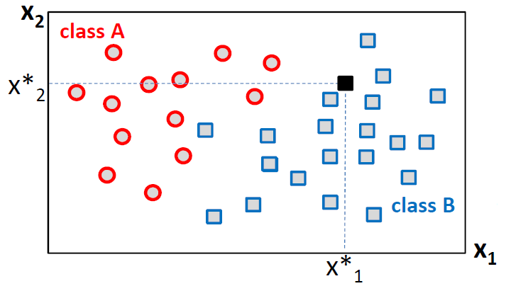
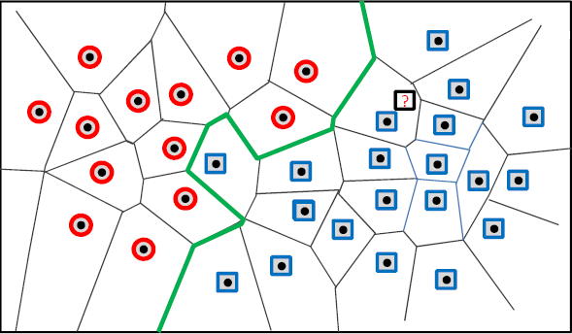

K-NN (K-Nearest Neighbors)
• Which class does belong to?
• Key point: nearby points => same class
• Based on the idea that closer two objects are in space, the more similar they are.
• Need a good distance function to establish similarity
Voronoi Diagram
• Partitions the whole space into cells and finds the most similar training data point to □ and predicts class
• A complicated decision boundary (nonlinear—composed of broken straight lines) which separates the classes well

Slide 34
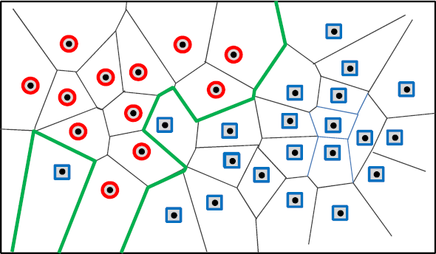
K-NN (K-Nearest Neighbors)
• What happens when you change the class label of a single data point?
Creates a dramatic change in the decision
boundary which is not desirable.
We don’t want small changes in the data to have large effects on the prediction.
• Is there a way to make kNN sensitive to data counts?
• How about using more than one nearest neighbor for class prediction?
• Spot the “k” most similar neighbors to the new data and count class labels
• Metric for quantifying similarity : “distance”

Slide 35
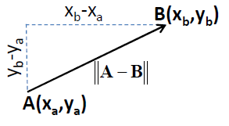
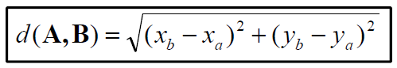
K-NN (K-Nearest Neighbors)
• Distance between neighbors?
• A key component of kNN algorithm
– A metric for measuring how similar instances are
– Has a strong impact on classification performance
• k neighbors that are closest to the new data point “x” are determined by a distance measure
• Measures of distances used in kNN:
• Euclidian distance
– Euclidian (L2 norm) distance in 2D (valid for numerical variables)

Slide 36
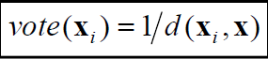
K-NN (K-Nearest Neighbors)
Once we find x’s nearest neighbors using the distance function, neighbors vote to predict x’s class:
• Method 1: Majority voting
All votes are equal and majority (democracy) wins
• Method 2: Weighted voting
Closer neighbors get higher votes (shareholder democracy)
1. Distance-based weight: A neighbor’s vote is the inverse of its distance to x:
2. Heuristic: Based on domain-specific characteristics of neighbors

Slide 37
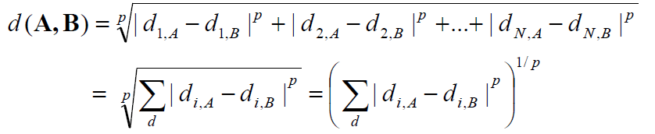
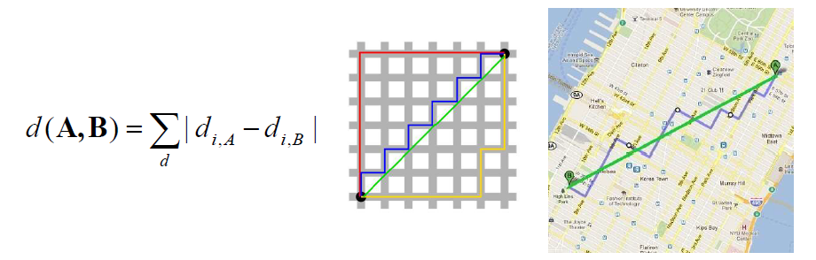
K-NN (K-Nearest Neighbors)
• Minkowski distance (m-norm)
• If p=2 => Euclidian distance (L2 norm)
• If p=1 => Manhattan distance (L1 norm)
• If p=0 => Hamming distance

Slide 38
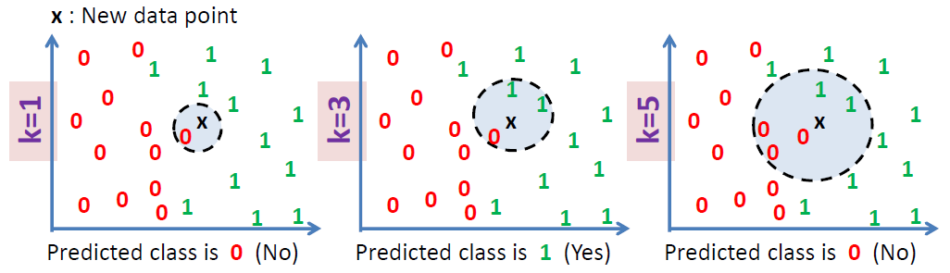
K-NN (K-Nearest Neighbors)
Neighbor counts?
k is an odd value for no ties
As k gets larger (larger neighborhood) New data point gets classified as the most probable class (large bias, inaccurate estimation)
As k gets smaller (smaller neighborhood) Sensitive to noise and highly variable (unreliable estimation as a consequence of overfitting)

Slide 39
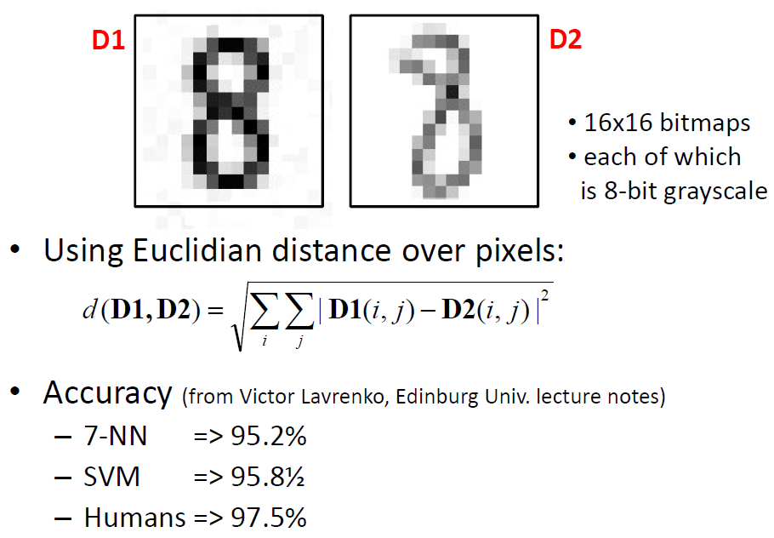
K-NN (K-Nearest Neighbors)
Some Applications of kNN
Classification (hand-written digits)

Slide 40
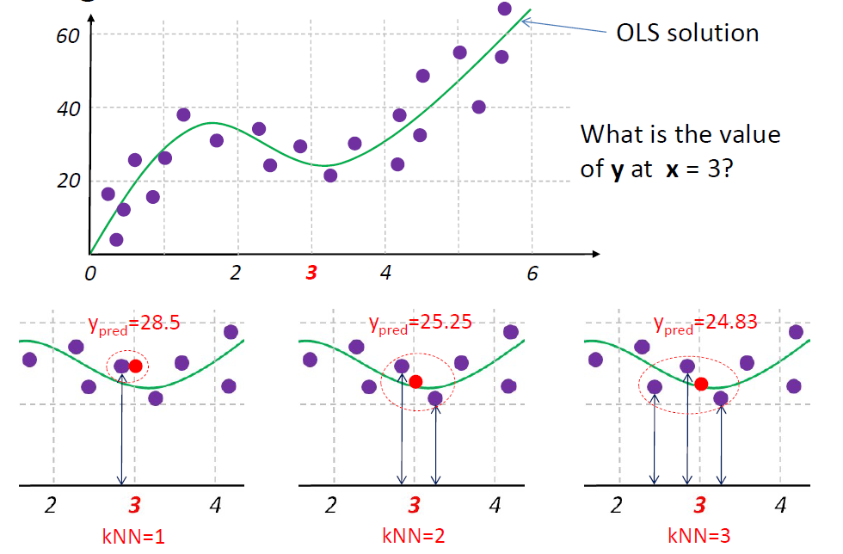
K-NN (K-Nearest Neighbors)
2. Regression via kNN

Slide 41
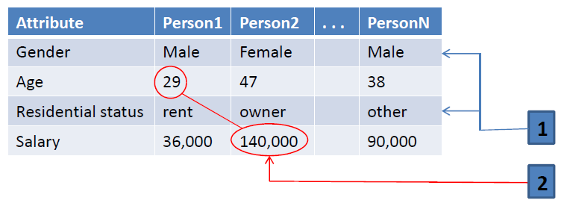

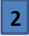
K-NN (K-Nearest Neighbors)
Issues with kNN
Heterogeneous attributes and differences in scale
Issues:
Distance issue with categorical attributes
• For distance computations, “gender” and “residential status”
variables must be encoded numerically.
e.g. {male=0,female=1}
Numerical variables with very different scales
• Need to apply scaling (normalization)
• Without scaling, our distance function will treat 10 TL
difference in salary as significant as 10 years difference in age

Slide 42
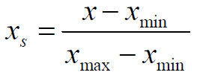
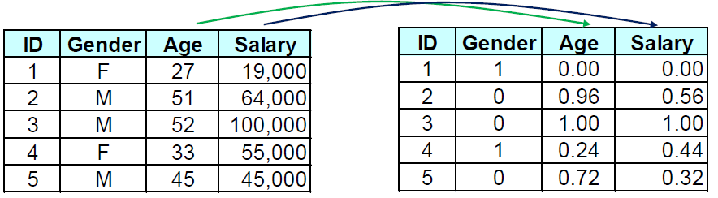

K-NN (K-Nearest Neighbors)
• Data Scaling
- As the distance between data points is essential in kNN algorithm, attribute scaling is critical.
-Min-Max scaling:
-Normalizing (standardization) data:
(0 mean, unit variance)

Slide 43


K-NN (K-Nearest Neighbors)
• Why the need for scaling?

Slide 44
K-NN (K-Nearest Neighbors)
Issues with kNN – cont’d
• How many neighbors and how much influence
– Influence of neighbors to prediction
– How distance is calculated between neighbors?
– How should one choose k (number of neighbors)?
• Dimensionality and data
– Having too many attributes
– Having irrelevant attributes
– Heterogeneous attributes (distance?)
– Gets affected by largely unbalanced datasets as is the case with most classifiers
• Computational efficiency
– No training required (storage of incidents only)
– Classification is slow and computationally expensive
– Not suitable for fast predictions (e.g. online ads)

Slide 45
K-NN (K-Nearest Neighbors)
kNN w/ Python
#using scikit-learn library
from sklearn.neighbors import KNeighborsClassifier
from sklearn.metrics import accuracy_score
#kcv is the optimum k value found via CV
Clf = KNeighborsClassifier(n_neighbors=kcv)
Clf.fit(X_train, y_train)
accuracy_score(y_test, Clf.predict(X_test))
#Hyperparameters tuned:
#n_neighbors:number of neighbors, metric: metric to use for computing distance

Slide 46
K-NN (K-Nearest Neighbors)
Some images and notes were retrieved from Aurélien Géron - Hands-on Machine Learning with Scikit-Learn and TensorFlow (2017, O’Reilly)

